Slide 1
Depth First Search

Slide 2
Depth First Search
Vertices of a graph are searched depth wise
A
A
A
I
D
F
I
D
F
I
D
F
B
C
B
C
B
C
H
E
H
E
H
E
G
G
G

Slide 3
Depth First Search
Vertices of a graph are searched depth wise
Adjacency list representation
1
18
adj[0]
4
8
4
8
5
5
5
adj[1]
6
3
7
6
3
7
2
17
adj[2]
8
5
4
3
16
8
5
4
11
7
12
2
8
2
2
8
7
8
7
adj[3]
7
1
7
1
6
7
adj[4]
2
6
2
6
0
0
0
0
0
adj[5]
2
8
7
2
8
7
4
6
4
6
1
4
6
1
3
1
3
3
adj[6]
4
1
8
4
1
8
adj[7]
8
1
3
5
8
5
8
4
15
9
14
10
13
5
1
3
adj[8]
5
2
5
2
6
6
0
7
0
7

Slide 4
Depth First Search Tree
The parent child relationship creates a spanning tree
5
2
8
7
0
4
6
1
3

Slide 5
Depth First Search Edges
E
B
G
e7
e14
e1
1
12
8
11
13
16
e13
e9
e3
e6
e8
A
2
7
9
10
e12
e4
e10
F
e2
3
4
5
6
14
15
C
e5
D
e11
H
Tree edges:
e1 e2 e4 e7 e9 e12
Forward edges:
e6
(From ancestor to descendent)
Backward edges:
e3
(From descendent to ancestor)
Cross edges:
e5
e8
e10
e1
e13
e14
(No relationship)

Slide 6
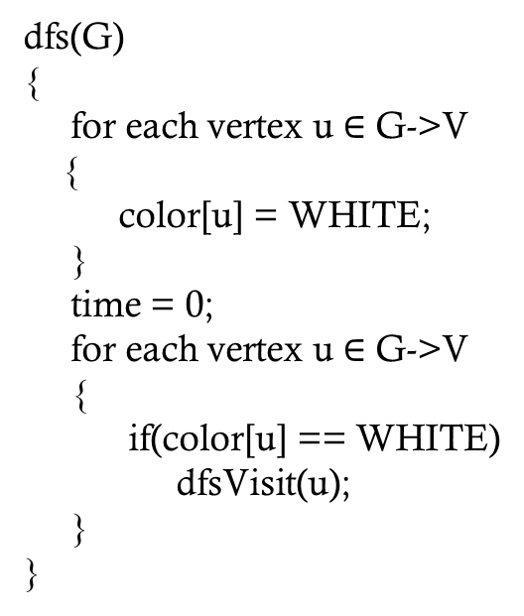
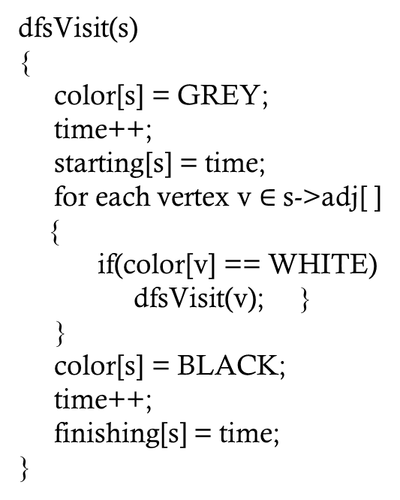
Depth First Search
dfs(G)
{
for each vertex u $∈$ G->V
{
color[u] = WHITE;
}
time = 0;
for each vertex u $∈$ G->V
{
if(color[u] == WHITE)
dfsVisit(u);
}
}
dfsVisit(s)
{
color[s] = GREY;
time++;
starting[s] = time;
for each vertex v $∈$ s->adj[ ]
{
if(color[v] == WHITE)
dfsVisit(v); }
}
color[s] = BLACK;
time++;
finishing[s] = time;
}

Slide 7
COURSE PRE-REQUISITION
In the following graph a directed edge (u, v) denotes that u is a pre-requisition of v
Suggest a linear ordering of courses so that there is no conflict of pre-requisition
105
203
215
205
220
169
279
Seq 1:
105
203
215
205
220
169
279
Seq 2:
169
105
205
203
279
215
220
Seq 3:
X
WRONG SEQUENCE
105
169
205
279
220

Slide 8
COURSE PRE-REQUISITION
Is it possible to do any linear ordering in the graph?
105
203
NO
But why?
Because there exists a circular dependency
Means there is a cycle
205
But the linear ordering was done successfully in the following graph
105
203
215
205
220
169
279
Aren’t the blue edges creating cycle?
NO
Because the edges are directed and the blue edges do not create directed cycle

Slide 9
DIRECTED ACYCLIC GRAPH (DAG)
If a directed graph contains no cycle then the graph is called DAG
DAG
Not a DAG
Not a DAG
Linear ordering of vertices of a graph is possible if the graph is a DAG

Slide 10
TOPOLOGICAL SORT
Linear ordering of a DAG is called Topological Sort (Top Sort)
A linear ordering of all vertices of a graph G such that
vertex u comes before vertex v
If (u, v) is an edge in G
DAG indicates precedence among events
Events are graph vertices
Edges (u, v) or (u to v) means that, u has a precedence over v
Topological sort is not unique

Slide 11
TOPOLOGICAL SORT ALGORITHM-1
Step-1
Apply dfs from a unvisited vertex
Step-2
Add the vertex in a stack that is completely visited
Step-3
Return to Step-1

Slide 12
TOPOLOGICAL SORT ALGORITHM-1
105
203
215
205
220
169
279
Sorted list:
169
279
105
203
215
205
220

Slide 13
TOPOLOGICAL SORT ALGORITHM-1
Def^{n}
105
203
215
A linear ordering of all vertices of G such that
vertex u comes before vertex v
If (u, v) is an edge in G
205
220
169
279
Sorted list:
169
279
105
203
215
205
220

Slide 14
TOPOLOGICAL SORT ALGORITHM-1
Consider “203” as starting vertex
105
203
215
205
220
169
279
Sorted list:
169
279
105
205
203
220
215

Slide 15
TOPOLOGICAL SORT ALGORITHM-1
Consider “203” as starting vertex
Def^{n}
105
203
215
A linear ordering of all vertices of G such that
vertex u comes before vertex v
If (u, v) is an edge in G
205
220
169
279
Sorted list:
169
279
105
205
203
220
215

Slide 16
TOPOLOGICAL SORT ALGORITHM-1
DFS(G)
{
for each vertex u ∈ G->V
{
u->color = WHITE;
}
st ← Ø
for each vertex u ∈ G->V
{
if (u->color == WHITE)
DFS_Visit(u);
}
return st;
}
DFS_Visit(u, &st)
{
u->color = GREY;
for each v ∈ u->Adj[]
{
if (v->color == WHITE)
DFS_Visit(v);
}
st->push(u);
}
O(n+e)

Slide 17
TOPOLOGICAL SORT ALGORITHM-2
Step-1
Find a vertex with in-degree = 0
Step-2
Remove the vertex and add the vertex in the sorted list
Step-3
Return to Step-1

Slide 18
TOPOLOGICAL SORT ALGORITHM-2
v2
v2
v4
v4
v7
v7
v1
v1
v5
v5
v6
v3
v6
v3
Sorted list:
v6
v2
v4
v5
v1
v7
v3

Slide 19
TOPOLOGICAL SORT ALGORITHM-2
topSort(adj(G))
Set the in-degree of all vertices
O(n²)
Do for n times
u is the vertex with in-degree = 0
O(n)
O(n²)
Add u in the sorted list
O(1)
Clear the u-th row of adj(G)
O(n)
Decrement the in-degree of the adjacent vertices of u by 1
O(n)
O(n²)

Slide 20
STRONGLY CONNECTED COMPONENT
In a directed graph G
Strongly Connected Component (SCC) of G is a maximal set of vertices
with a directed path between every pair of vertices
Problem Statement
To find all the SCC from a given directed graph G

Slide 21
STRONGLY CONNECTED COMPONENT
Is {h, f} a SCC?
h
f
a
e
NO
Though there is a directed path
between h and f
But g can be added to the list
g
c
b
d
Means {h, f} is not the maximal
SCC #1: {h, f, g}
Which one is the maximum among the SCCs?
SCC #2: {b, c}
{h, f, g}
SCC #3: {a, e}
SCC #4: {d}

Slide 22
COMPONENT GRAPH
Q
{a,e}
h
f
a
e
P
S
{h,f,g}
{d}
g
c
b
d
{b,c}
R
The component graph is a DAG
The SCCs have been marked as P, Q, R, S
Why is it a DAG?
First try to make it a Not DAG
Add an edge from a to f
So there will be an edge from Q to P in the component graph
But in that case, {h,f,g} and {a,e} will be a single component and P & Q will be the same

Slide 23
COMPONENT GRAPH
Q
{a,e}
h
f
a
e
P
S
{h,f,g}
{d}
g
c
b
d
{b,c}
R
The component graph is a DAG
The SCCs have been marked as P, Q, R, S
Why is it a DAG?
First try to make it a Not DAG
Add an edge from a to f
So there will be an edge from Q to P in the component graph
But in that case, {h,f,g} and {a,e} will be a single component and P & Q will be the same

Slide 24
SCC ALGORITHM
Q
{a,e}
h
f
a
e
P
S
{h,f,g}
{d}
g
c
b
d
{b,c}
R
Apply dfs from any vertex
Add a vertex at the front of a list when all the children are visited
Transpose the graph
Apply dfs as per the sequence of the list

Slide 25
SCC ALGORITHM
Q
a
e
{a,e}
h
f
P
S
{h,f,g}
{d}
g
c
b
d
{b,c}
R
h
f
a
e
List:
f
g
h
a
e
b
d
c
P
Q
R
S
g
c
b
d

Slide 26
Thank you!
Any Questions?

